Slide 1

2021 Cyber Safety Insights Report Global Results
– GAMING
November 2021
Presented by:

Slide 2









Survey Method
Online Survey
5,327 Adults
8 Countries
The research was conducted online by The Harris Poll on behalf of NortonLifeLock among 5,327 adults (aged 18+) who currently play online games that require them to create an account and provide personal information (referred to in this report as “gamers”). The survey was conducted August 24 – September 14, 2021 in Australia (n=704), France (n=701), Germany (n=701), India (n=703), Japan (n=606), New Zealand (n=505), the United Kingdom (n=705), and the United States (n=702).
Data are weighted where necessary to bring them in line with their actual proportions in the population; India was weighted to the population of those who are online. Weighted variables varied by country and included one or more of the following: age, gender, race/ethnicity, region, education, marital status, internet usage, household size, household income, size of place, and propensity to be online. A global post-weight was applied to ensure equal weight of each country in the global total.
UK
n=705
Germany
n=701
Japan
US
n=701
n=702
France
n=606
India
n=703
Australia
n=704
New Zealand
n=505

Slide 3






Table of Contents
1
2
3
Pages 4-9
Pages 10-15
Pages 16-22
Impact of Pandemic on Gaming Habits
Compromising Gaming Behaviors
Gamer Profile
4
5
6
Pages 23-31
Pages 32-36
Pages 37-38
Security Attitudes & Behaviors
Gaming Attacks
Demographics

Slide 4
Gamer Profile
1
Tablet or mobile gaming is the top method of choice for two-thirds of gamers globally, and half of gamers report playing on a computer. The majority describe themselves as casual gamers, though one in five self-identify as hardcore gamers. For at least three in five gamers, playing online games is preferable to many other social activities, such as going on a date, attending a sporting event or concert, or going to a friend or family member’s birthday party.

Slide 5




The Majority of Gamers Globally Play Using a Mobile Device, About Half Play On a PC
Devices Used To Play Online Games
GLOBAL TOTAL
Tablet/Mobile
Computer
Video Game Console
Another Device
66%
65%
61%
55%
84%
62%
62%
64%
71%
51%
55%
55%
57%
47%
45%
52%
45%
49%
42%
46%
39%
45%
32%
43%
29%
53%
51%
8%
7%
5%
9%
10%
8%
5%
7%
11%
Notes:
BASE: ALL QUALIFIED RESPONDENTS
Q600 Do you currently play any online games that require you to create an account where you provide personal information (e.g., name, email address, financial information, etc.)? Please select all that apply.

Slide 6

While More Than Six in Ten Gamers Identify as Casual Gamers, Around One in Five Describe Themselves as Hardcore Gamers
casual gamer
% Yes
(Global Total)
Casual gamer
New/fairly inexperienced in the world of gaming
Hardcore gamer
Professional gamer (i.e., I make money from playing and/or streaming games)
Notes:
BASE: ALL QUALIFIED RESPONDENTS
Q800 Which of the following are true for you?

Slide 7
At Least Half of Gamers Around the World Say They Are Casual Gamers
% Yes by Country
Casual gamer
New/fairly inexperienced in the world of gaming
Hardcore gamer
Professional gamer
70%
49%
65%
52%
59%
72%
65%
62%
38%
41%
32%
37%
34%
42%
30%
30%
16%
29%
19%
28%
14%
15%
20%
25%
5%
6%
7%
17%
1%
2%
4%
9%
Notes:
BASE: ALL QUALIFIED RESPONDENTS
Q800 Which of the following are true for you?

Slide 8
Nearly Half of Gamers Globally Say They Would Rather Spend Time Gaming Than Go on a Vacation
Would Rather Spend Time Gaming Than…
(Global Total)
Notes:
BASE: ALL QUALIFIED RESPONDENTS
Q805 Which of the following would you rather do than spend time gaming? Please select all that apply.

Slide 9
A
Across Countries, Gaming Is Preferable to Several Social Activities, Including Concerts, Sporting Events, Dates, and Birthday Parties
Would Rather Spend Time Gaming Than…
(Top 3 by Country)
Attend a sporting event or concert
Attend a sporting event or concert
Go on a date
Go on a date
Go on a date
Go on a date
Attend a sporting event or concert
Attend a sporting event or concert
Read a book
Read a book
Read a book
Attend a friend/family member's birthday party
Attend a friend/family member's birthday party
Go on a date
Go on a date
Attend a sporting event or concert
Go on a date
Attend a sporting event or concert
Attend a sporting event or concert
Go on a date
Attend a sporting event or concert
Read a book
Read a book
Read a book
Notes:
BASE: ALL QUALIFIED RESPONDENTS
Q805 Which of the following would you rather do than spend time gaming? Please select all that apply.

Slide 10
Impact of Pandemic on Gaming Habits
2
The COVID-19 pandemic seems to have glued more eyes to gaming devices, for longer. Close to three in ten gamers globally report picking up gaming during the pandemic, and nearly two in five say their time spent playing online games increased during the pandemic. Of those who spent more time gaming than before, nearly all felt impacts, some positive and some negative. Still, online gaming is here to stay – the majority say they will spend about the same amount of time playing online games in the future as they did during the pandemic, and another one in six believe that they will spend more time gaming in the future.

Slide 11
Many Gamers Report That They Started Gaming, or Increased the Amount They Were Already Gaming, During the Pandemic
GLOBAL
TOTAL NET
Australia | France | Germany | India | Japan | New Zealand | UK | US
Time Spent Playing Online Games Increased during the Pandemic
Started Online Gaming During the Pandemic
Notes:
BASE: ALL QUALIFIED RESPONDENTS
Q800 Which of the following are true for you?
Q1000 Thinking about your online gaming habits since the start of the COVID-19 pandemic, has the amount of time you spend playing online games increased, decreased, or stayed about the same?

Slide 12


Of Those Who Reported Their Online Gaming Habits Increased, Three in Four Report Experiencing Positive Impacts; Two in Five Report Negative Impacts
Impacts of Increased Gaming Time During the Pandemic
(Global Total of Those Whose Gaming Time Increased During the Pandemic)
POSITIVE IMPACT NET
Helped to decrease my anxiety or stress
Helped me make new friends online
Helped me feel a sense of community
Made me feel closer with my family
Positively impacted a relationship with significant other
NEGATIVE IMPACT NET
Made me feel isolated or lonely
Has caused greater anxiety or stress
Has strained my relationship with my family
Has contributed to a breakup with a significant other
76%
43%
36%
25%
22%
18%
40%
19%
18%
18%
10%
Notes:
BASE: GAMING TIME INCREASED DURING PANDEMIC
Q1005 You mentioned the amount of time you spend playing online games has increased since the start of the COVID-19 pandemic. How has this impacted you? Please select all that apply.

Slide 13
The Most Common Positive Impact Felt in Most Countries Is a Decrease in Anxiety or Stress
Positive Impacts of Increased Gaming Time During the Pandemic by Country
(Of Those Whose Gaming Time Increased During the Pandemic)
POSITIVE IMPACT NET
Helped to decrease my anxiety or stress
Helped me make new friends online
Helped me feel a sense of community
Made me feel closer with my family
Positively impacted a relationship with significant other
79% | 74% | 63% | 89% | 60% | 75% | 75% | 83%
46% | 37% | 34% | 54% | 26% | 45% | 45% | 53%
34% | 31% | 30% | 53% | 34% | 32% | 29% | 32%
23% | 30% | 25% | 38% | 8% | 21% | 23% | 24%
21% | 17% | 10% | 34% | 17% | 20% | 20% | 27%
18% | 17% | 14% | 30% | 9% | 16% | 18% | 15%
Notes:
BASE: GAMING TIME INCREASED DURING PANDEMIC
Q1005 You mentioned the amount of time you spend playing online games has increased since the start of the COVID-19 pandemic. How has this impacted you? Please select all that apply.

Slide 14
On the Other Hand, the Most Common Negative Effects Are Feelings of Isolation, Loneliness, and Greater Anxiety or Stress
Negative Impacts of Increased Gaming Time During the Pandemic by Country
(Of Those Whose Gaming Time Increased During the Pandemic)
NEGATIVE IMPACT NET
Made me feel isolated or lonely
Has caused greater anxiety or stress
Has strained my relationship with my family
Has contributed to a breakup with a significant other
40% | 45% | 41% | 55% | 24% | 33% | 40% | 41%
16% | 30% | 18% | 26% | 11% | 14% | 14% | 19%
17% | 15% | 15% | 25% | 15% | 16% | 18% | 17%
14% | 18% | 22% | 27% | 4% | 18% | 15% | 20%
13% | 4% | 6% | 24% | 3% | 6% | 10% | 7%
Notes:
BASE: GAMING TIME INCREASED DURING PANDEMIC
Q1005 You mentioned the amount of time you spend playing online games has increased since the start of the COVID-19 pandemic. How has this impacted you? Please select all that apply.

Slide 15


The Trend of Increased Gaming May Continue for Some as More Than One in Ten Gamers Across the Globe Say They Will Spend More Time Gaming in the Future
Time Spent Playing Online Games in the Future Compared to During the COVID-19 Pandemic
GLOBAL TOTAL
More time
About the same amount of time
Less time
Notes:
BASE: ALL QUALIFIED RESPONDENTS
Q1010 Thinking ahead to the future, do you think you will spend more time, less time, or about the same amount of time playing online games than you have during the COVID-19 pandemic?

Slide 16
Compromising Gaming Behaviors
3
Globally, over half of gamers are very or extremely concerned about online security when playing games, with personal information security at the forefront of their concerns. Further, nearly three-quarters say they would be very upset or devastated if their personal information was stolen in a gaming account hack. Yet, gamers admit they would be willing to take actions that would compromise their online security to gain a competitive advantage, including being on the attack themselves: over one in four say they are at least somewhat likely to hack into a random player, or friend or family member’s gaming account.

Slide 17

More Than Half of Gamers Are Very or Extremely Concerned About Various Security Aspects When Playing Online Games
Aspects Concerned About While Playing Games Online
(Global Total)
Extremely Concerned
Very Concerned
The security of my personal information
Hidden fees
Malware or phishing attacks targeting my gaming account
Bugs (vulnerabilities) in games that could be exploited and lead to hackers spying on me
My personal privacy from other players
Online harassment or cyberbullying
Other players cheating to gain competitive advantages
In-game digital currency, characters, or other items being lost or stolen
Other players using pay-to-win practices
57%
55%
55%
53%
52%
48%
46%
45%
41%
Notes:
BASE: ALL QUALIFIED RESPONDENTS
Q810 How concerned are you about each of the following aspects when playing games online?

Slide 18
Gamers Across the World Most Commonly Note Concern About the Security of Their Personal Information While Playing Games Online
% Very/Extremely Concerned by Country
The security of my personal information
Hidden fees
Malware or phishing attacks targeting my gaming account
Bugs (vulnerabilities) in games that could be exploited and lead to hackers spying on me
My personal privacy from other players
Online harassment or cyberbullying
Other players cheating to gain competitive advantages
In-game digital currency, characters, or other items being lost or stolen
Other players using pay-to-win practices
57% | 55% | 44% | 71% | 55% | 57% | 56% | 58%
54% | 57% | 51% | 60% | 45% | 60% | 57% | 58%
56% | 58% | 44% | 67% | 47% | 54% | 55% | 58%
54% | 45% | 41% | 68% | 47% | 56% | 56% | 56%
54% | 45% | 39% | 68% | 48% | 48% | 55% | 58%
50% | 50% | 39% | 65% | 39% | 44% | 49% | 45%
46% | 41% | 44% | 61% | 46% | 42% | 44% | 45%
44% | 47% | 41% | 58% | 39% | 40% | 46% | 46%
42% | 36% | 39% | 55% | 31% | 37% | 44% | 42%
Notes:
BASE: ALL QUALIFIED RESPONDENTS
Q810 How concerned are you about each of the following aspects when playing games online?

Slide 19

Gamers Admit Willingness to Take Actions That Could Compromise the Security of Themselves or Others Simply to Give Themselves a Competitive Advantage
Likeliness to Take Action if it Would Provide a Competitive Advantage
(Global Total % At Least Somewhat Likely)
44%
40%
37%
34%
Pay an in-game one-off or monthly fee
Exploit a loophole or bug in the game
Pay for modification software for your game
Install cheats to my gaming account and/or gaming device
29%
27%
27%
Pay to take possession of another user's gaming account online
Hack into the gaming account of a random player
Hack into the gaming account of a friend, family member, or romantic partner
Notes:
BASE: ALL QUALIFIED RESPONDENTS
Q815 How likely would you be to take each of the following actions if you knew they would give you a competitive advantage in an online game?

Slide 20

Across Countries, Many Gamers Are Willing to Spend Money to Gain a Competitive Advantage, either by Paying a Monthly Fee or Paying for Modification Software
% At Least Somewhat Likely by Country
Pay an in-game one-off or monthly fee
Exploit a loophole or bug in the game
Pay for modification software for your game
Install cheats to my gaming account and/or gaming device
Pay to take possession of another user's gaming account online
45% | 31% | 48% | 64% | 40% | 32% | 43% | 50%
43% | 34% | 41% | 56% | 23% | 35% | 43% | 46%
40% | 27% | 42% | 63% | 17% | 29% | 35% | 44%
36% | 40% | 35% | 46% | 22% | 23% | 34% | 39%
30% | 25% | 31% | 48% | 15% | 19% | 30% | 35%
Notes:
BASE: ALL QUALIFIED RESPONDENTS
Q815 How likely would you be to take each of the following actions if you knew they would give you a competitive advantage in an online game?

Slide 21


Further, Some Gamers Across the World Say They Would Hack Into Someone Else’s Account to Gain an Advantage
% At Least Somewhat Likely by Country
29%
28%
27%
25%
17%
18%
35%
34%
25%
21%
39%
42%
Hack into the gaming account of a random player
29%
28%
Hack into the gaming account of a friend, family member, or romantic partner
17%
18%
Notes:
BASE: ALL QUALIFIED RESPONDENTS
Q815 How likely would you be to take each of the following actions if you knew they would give you a competitive advantage in an online game?

Slide 22
On the Other Hand, if Their Gaming Account Was Hacked, the Majority of Gamers Would Be Very Upset or Devastated if Their Personal Information Was Stolen
% Very Upset/Devastated
GLOBAL TOTAL
Your personal information was stolen
You lost your account
You lost your digital currency
You lost the progress you made in the game
You lost digital items that you earned or purchased (e.g., skins, inventory, etc.)
You lost your character
74%
61%
57%
51%
51%
45%
75% | 70% | 69% | 71% | 75% | 80% | 71% | 79%
61% | 54% | 63% | 66% | 62% | 59% | 55% | 67%
58% | 53% | 55% | 65% | 50% | 61% | 51% | 62%
51% | 46% | 51% | 57% | 55% | 46% | 50% | 56%
50% | 40% | 54% | 58% | 50% | 54% | 48% | 54%
43% | 36% | 46% | 56% | 45% | 41% | 41% | 50%
Notes:
BASE: ALL QUALIFIED RESPONDENTS
Q915 If your gaming account was hacked, how upset would you be if…?

Slide 23
Security Attitudes And Behaviors
1
Gamer attitudes and behaviors are often at odds when it comes to online security. The majority of gamers say they go to great lengths to keep their gaming accounts secure, yet more than two in five see antivirus software as a luxury and not a necessity. Despite many saying they trust gaming companies to protect their personal information, nearly four in five think gaming companies should do a lot more to secure their platforms and products.

Slide 24
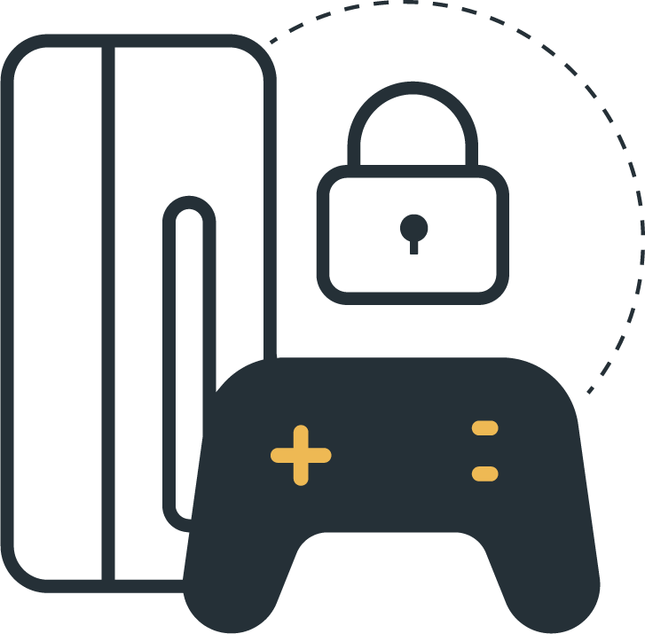
Gamers Trust Gaming Companies to Protect Their Personal Information, but They Also Take Their Own Preventative Steps to Protect Their Accounts
% Agree
GLOBAL TOTAL
I go to great lengths to keep my gaming accounts secure
I trust gaming companies (e.g., Blizzard, Ubisoft, Steam, etc.) will protect my personal information and data
Notes:
BASE: ALL QUALIFIED RESPONDENTS
Q900 How much do you agree or disagree with the following statements?

Slide 25
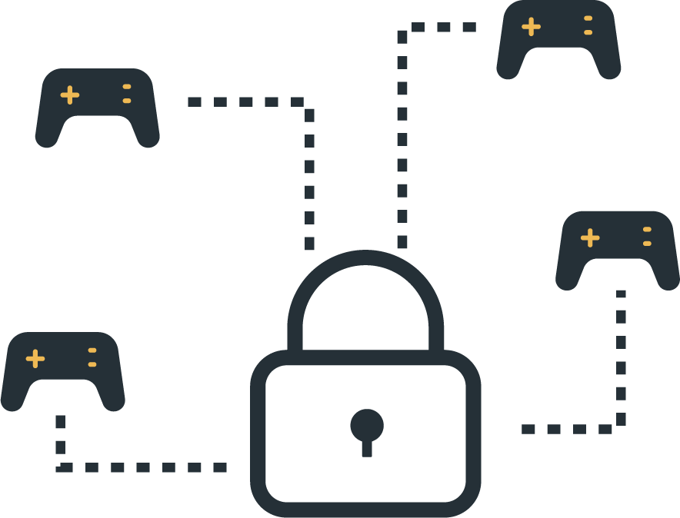
Many Feel Companies Could Be Doing More to Secure Their Platforms and Worry What the Future of Gaming Security Will Look Like
% Agree
GLOBAL TOTAL
Gaming companies (e.g., Blizzard, Ubisoft, Steam, etc.) should do a lot more to secure their platforms and products
I worry that gaming will become less secure in the future
Notes:
BASE: ALL QUALIFIED RESPONDENTS
Q900 How much do you agree or disagree with the following statements?

Slide 26





Gamers’ Trust in Gaming Companies to Protect Their Personal Information Falls Below Trust in Banks, Streaming Services, Internet Providers, and Online Retailers
Trust Placed in Companies and Services When it Comes to Managing and Protecting Personal Information
(Global Total)
GAMING COMPANIES
(e.g., Blizzard, Ubisoft,
Steam, etc.)
23%
56%
TRUST A LOT
TRUST A LITTLE
TRUST A LITTLE/A LOT
Banks and financial services companies
On-demand streaming services
Internet service providers
Retailers/Online shopping sites
Social media companies
Notes:
BASE: ALL QUALIFIED RESPONDENTS
Q700 How much do you trust each of the following types of companies and services when it comes to managing and protecting your personal information?
When we refer to personal information, we mean information that could be used to identify you such as your date of birth, home address, account numbers, and login credentials for online accounts. It could also include other information related to your individual location, online search history, online purchases, financial information, and health records.

Slide 27
In Fact, Only a Small Proportion of Gamers Across Countries Say They Trust Gaming Companies a Lot When It Comes to Protecting Their Personal Information
Trust Placed in Gaming Companies by Country
81%
81%
83%
81%
77%
75%
78%
74%
Trust A Little
Trust A Lot
Notes:
BASE: ALL QUALIFIED RESPONDENTS
Q700 How much do you trust each of the following types of companies and services when it comes to managing and protecting your personal information?
When we refer to personal information, we mean information that could be used to identify you such as your date of birth, home address, account numbers, and login credentials for online accounts. It could also include other information related to your individual location, online search history, online purchases, financial information, and health records.

Slide 28
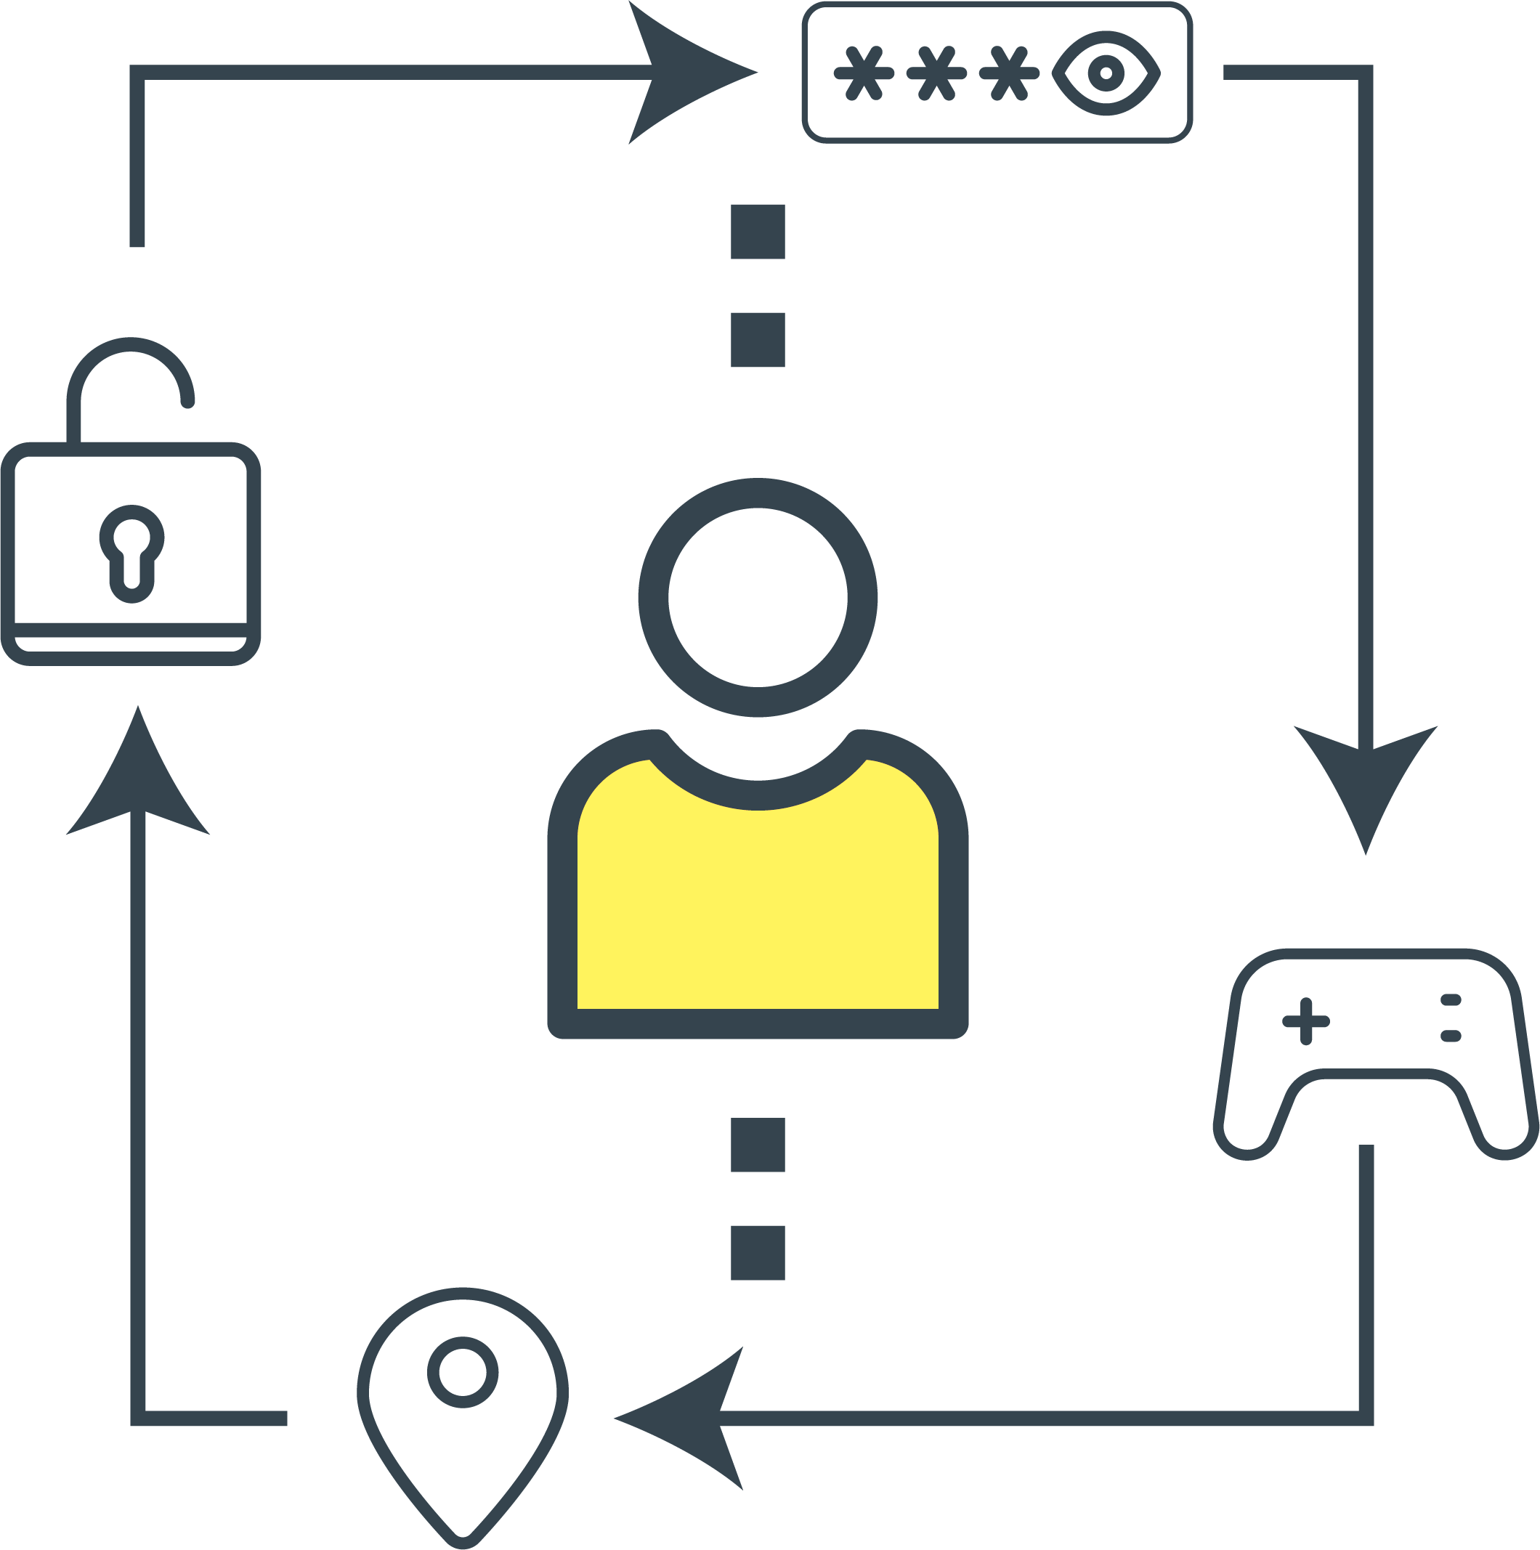
Gamers Admit to Partaking in a Variety of Risky Behaviors, With More Than a Quarter Globally Saying They Have Uninstalled Antivirus Software to Improve Game Quality or Speed
% Yes
(Global Total)
I have used the same username for more than one gaming account or device
I have used the same password for more than one gaming account or device
I have shared personal information (e.g., name, birthday, etc.) while playing a game online
I have used public Wi-Fi to play games online
I have downloaded a cheaper or free version of a game from a website that was not associated with the game distributer
I have downloaded add-ons (e.g., characters, skins, swag, etc.) from a website that was not associated with the game distributer
I have uninstalled antivirus software in the hopes of improving game quality or speed
Notes:
BASE: ALL QUALIFIED RESPONDENTS
Q905 Which of the following, if any, are true for you when it comes to online gaming?

Slide 29
Across Countries, Gamers Most Commonly Report Using the Same Username or Password for Multiple Gaming Accounts or Devices, and Sharing Personal Information
% Yes by Country
Have used the same username for more than one gaming account or device
Have used the same password for more than one gaming account or device
Have shared personal information (e.g., name, birthday, etc.) while playing a game online
Have used public Wi-Fi to play games online
Have downloaded a cheaper/free version of a game from a website that was not associated with the game distributer
Have downloaded add-ons from a website that was not associated with the game distributer
Have uninstalled antivirus software in the hopes of improving game quality or speed
55% | 50% | 42% | 60% | 42% | 58% | 54% | 54%
52% | 44% | 36% | 51% | 41% | 52% | 46% | 47%
38% | 42% | 52% | 64% | 26% | 35% | 37% | 39%
33% | 39% | 33% | 48% | 34% | 39% | 38% | 39%
31% | 35% | 30% | 45% | 20% | 30% | 29% | 29%
30% | 22% | 26% | 41% | 16% | 26% | 29% | 28%
27% | 20% | 28% | 42% | 21% | 23% | 32% | 24%
Notes:
BASE: ALL QUALIFIED RESPONDENTS
Q905 Which of the following, if any, are true for you when it comes to online gaming?

Slide 30





More Than Two in Five Gamers Globally See Antivirus and Security Software as a Luxury Rather Than a Necessity
% Agree
(Global Total)
46%
45%
42%
42%
40%
AGREE
AGREE
AGREE
AGREE
AGREE
Antivirus and security software does not protect me from the types of threats I face through gaming
I would rather spend my money on gaming hardware and set-up (e.g., headset, monitor, chair, etc.) than on antivirus and security software
I would rather pay for upgrades to my game than pay for antivirus and security software
Antivirus and security software is a luxury rather than a necessity for my online gaming accounts
All antivirus and security software slows down your gaming speed and isn't necessary
Strongly agree
Somewhat agree
Notes:
BASE: ALL QUALIFIED RESPONDENTS
Q910 How much do you agree or disagree with the following statements about antivirus and security software for online games?

Slide 31

In Fact, Many Gamers Would Rather Spend Money on Upgrades to Their Gaming Hardware, Set-up, or Game Than Spend Money on Antivirus and Security Software
% Agree by Country
Antivirus and security software does not protect me from the types of threats I face through gaming
46%
49%
46%
54%
38%
46%
47%
44%
I would rather spend my money on gaming hardware and set-up (e.g., headset, monitor, chair, etc.) than on antivirus and security software
52%
44%
40%
54%
31%
43%
46%
49%
I would rather pay for upgrades to my game than pay for antivirus and security software
45%
40%
38%
58%
30%
38%
44%
44%
Antivirus and security software is a luxury rather than a necessity for my online gaming accounts
44%
41%
34%
59%
31%
39%
42%
48%
All antivirus and security software slows down your gaming speed and isn't necessary
46%
38%
36%
56%
21%
36%
42%
44%
Notes:
BASE: ALL QUALIFIED RESPONDENTS
Q910 How much do you agree or disagree with the following statements about antivirus and security software for online games?

Slide 32
Gaming Attacks
1
Gamers seem to feel invincible; more than two in five gamers globally say they don’t think their gaming account will ever be hacked and admit they don’t give much thought to the safety of their gaming accounts and devices. However, when asked if they had ever experienced a series of gaming scams, close to half of gamers around the world report they have suffered an attack to their gaming accounts or devices. Further, nearly three in four gamers who experienced an attack were impacted financially as a result.

Slide 33

Gamers Express a Lack of Vigilance When It Comes to the Security of Their Gaming Accounts
% Agree
I don't give much thought, if any, to the security of my gaming accounts or devices
I don't think twice about sharing personal information when signing up for gaming accounts
Somewhat/Strongly Agree
Somewhat/Strongly Agree
49%
30%
49%
53%
33%
46%
47%
45%
44%
36%
46%
58%
30%
41%
42%
41%
44%
42%
AGREE
GLOBAL TOTAL
AGREE
GLOBAL TOTAL
Strongly Agree
Somewhat Agree
Somewhat Disagree
Strongly Disagree
Notes:
BASE: ALL QUALIFIED RESPONDENTS
Q900 How much do you agree or disagree with the following statements?

Slide 34
More Than Three in Five Gamers Globally Say They Would Never Fall For a Gaming Scam
% Agree
I don't think my gaming account(s) will ever be hacked
I would never fall for a gaming scam
Somewhat/Strongly Agree
Somewhat/Strongly Agree
48%
43%
48%
58%
36%
43%
47%
45%
69%
62%
46%
72%
45%
64%
65%
74%
46%
62%
AGREE
GLOBAL TOTAL
AGREE
GLOBAL TOTAL
Strongly Agree
Somewhat Agree
Somewhat Disagree
Strongly Disagree
Notes:
BASE: ALL QUALIFIED RESPONDENTS
Q900 How much do you agree or disagree with the following statements?

Slide 35
Yet, Close to Half of All Gamers Have Experienced an Attack to Their Gaming Accounts or Devices
Experienced Attacks to Their Gaming Account or Device
(Global Total)
Experienced Any Attack to Their Gaming Account or Device
42%
47%
48%
75%
22%
42%
42%
47%
Detected malicious software (e.g., spyware, ransomware, viruses, etc.) on a gaming device
Detected unauthorized access to an online gaming account
Been tricked into installing malware onto a gaming device
46%
Been tricked into sharing my gaming account information online
Had a gaming account stolen
GLOBAL TOTAL
Had in-game digital currency, characters, or other items stolen
HAVE EXPERIENCED AN ATTACK TO THEIR GAMING DEVICE
Was doxed (had personal information stolen and posted/shared online without consent)
Other attack
Notes:
BASE: ALL QUALIFIED RESPONDENTS
Q920 Which of the following, if any, have you ever personally experienced? Please select all that apply.

Slide 36

The Majority of Gamers Who Experienced an Attack to Their Gaming Account Were Impacted Financially as a Result
Experienced Financial Loss as a Result of an Attack to Their Gaming Account or Device
72%
GLOBAL TOTAL
Notes:
BASE: ALL QUALIFIED RESPONDENTS
Q925 You mentioned that you have experienced attacks to a gaming account or device. How much have you lost financially as a result?
Please think about the total amount lost or stolen, including the cost to repair or replace your device(s) or resolve the issue. Also include any amount that was stolen and then returned to you. If there was no financial loss, please enter ‘0’. If you are not sure, please provide your best estimate.

Slide 37
Demographics
6

Slide 38


2021 Global Demographics
Age
Gender
45%
female
55%
male
38

